Slide 1


BTech 451 Project Invasive Species Specialist Group (ISSG) End Of Semester Seminar
By Afshaa Sacranie

Slide 2
ISSG
The Invasive Species Specialist Group (ISSG) of the Species Survival Commission (SSC) of the International Union for Conservation of Nature (IUCN)
The ISSG’s three main areas of activity are:
policy and technical advice;
providing stakeholders access to information and
facilitating information exchange through promoting networks.

Slide 3
The Problem
Biological invasions
Island ecosystems mostly effected
Limited capacity, access to and availability of reliable information have been identified as barriers to effective management of the threat of biological invasions in the island groups
Promote and facilitate access to information, exchange of information, knowledge, experiences and best practice
This communication is through invasive species practitioner networks on island groups such as the Western Indian Ocean Islands, the Caribbean and the Pacific.

Slide 4
The Solution
The Western Indian Ocean Islands- Invasive Species Practitioners Network Portal (WIO-ISPN).
Helps carry out the various activities of the networks
The WIO-ISPN will be a portal that provides:
Bibliography database
Blog, list service / news update
a skills register where experts can register and list their competencies and expertise
language translator
and access to a webinar facility
RSS feed etc.

Slide 5
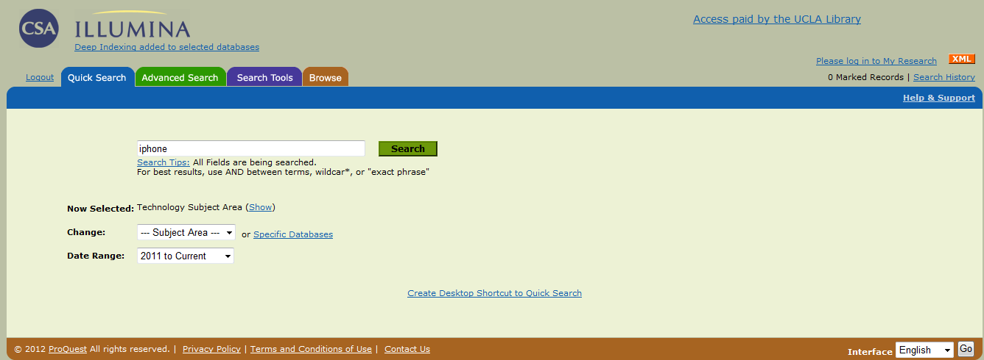
Example sites Bibliography Database(1)
Has quick and advanced search
Chose a topic on the invasive species

Slide 6
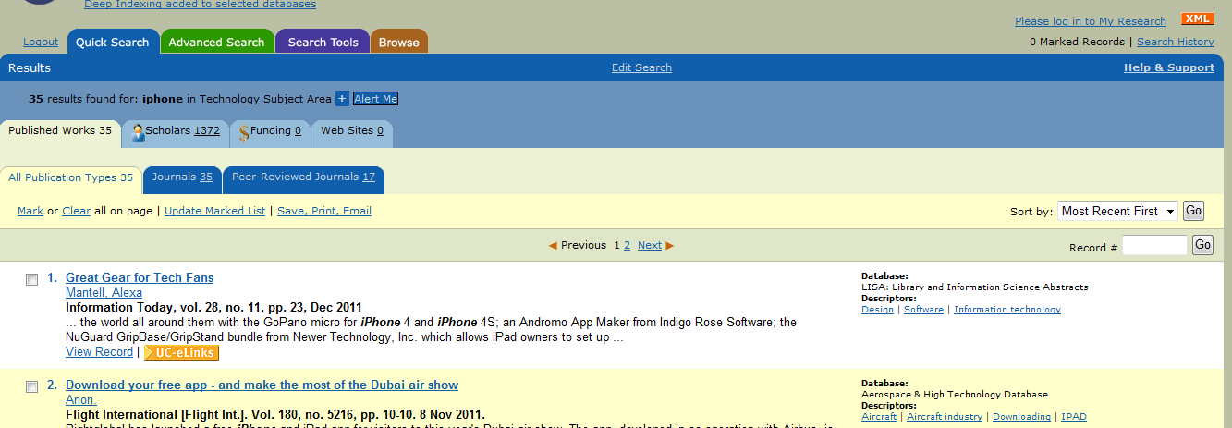
Example sites Bibliography Database(1)
Sort according to the type of resource
Results appear from most recently publish

Slide 7
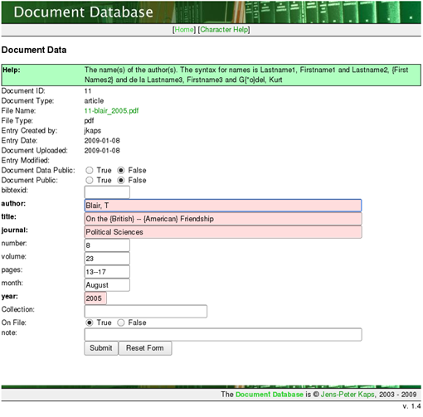
Example sites Bibliography Database(3)
To enter a resource/information into the database a network member will have to fill out a online form, inserting all information on the resource

Slide 8
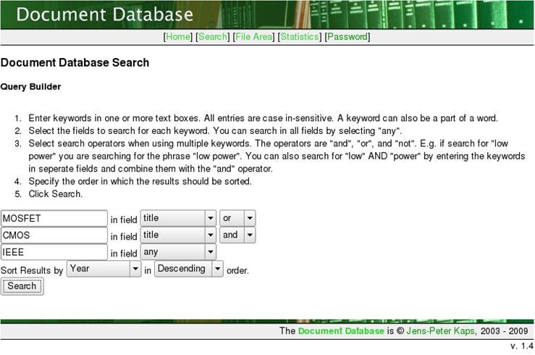
Example sites Bibliography Database(3)
A page to enter the tags/ metadata tags that will identify the resource and assist in the search of the resource

Slide 9
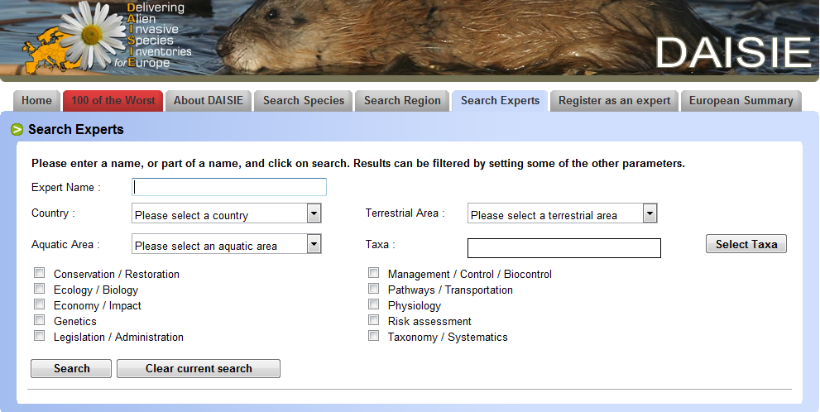
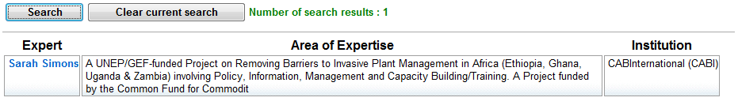
Example sites Skills Register(2)
Zimbabwe
African Inland water

Slide 10
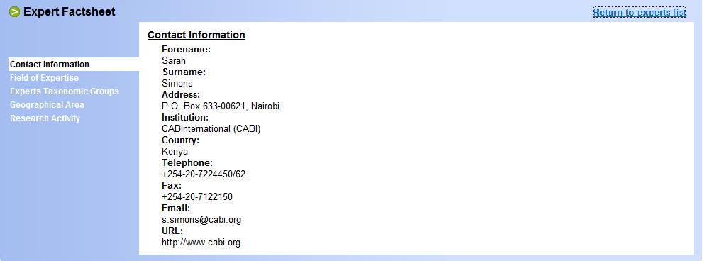
Example sites Skills Register(2)

Slide 11
Other information
Registering an expert to the site
The Blog – Google groups

Slide 12
The Road So Far
At the beginning there were a lot of meetings held to understand the ISSG’s goal for this project
To fully understand the purpose of the site
To understand who the audience is
ISSG members
People in the Western Indian Ocean Area
Invasive species specialists and experts
The next step was to create a request for proposal and a user specification document, to put on paper the information gathered so far
Researching various tools that can be used for implementation

Slide 13
Tools
Dotnetnuke
Only works on windows (not a major factor)
User friendly
MS SharePoint Server 2010
Can only have maximum 250 MB storage
Can be costly to maintain as more information is made available
Can work in collaboration with other MS tools which would be appropriate since we are looking to create the database in MS access and linking it to share point
Drupal
It has good tools, templates and themes that supports the initiation of the website and saves time
It takes time to load due to the number of its tools and capabilities

Slide 14
The Plan
To research on Drupal
If its is not the tool for this project then to either use MS SharePoint because we have access to it or find another fast and efficient tool
And to get started with the development process!!

Slide 15
References
http://csaweb108v.csa.com/ids70/quick_search.php?SID=o9u97tra9aed5lgbef099k7r93
http://www.europe-aliens.org/expertSearch.do
http://docdb.sourceforge.net/

